Slide 1

SIRIUS AI
AUGUST 2023

Slide 2

STATE OF AI
AI HISTORY & EVOLUTION
USE RESEARCH
OWNER : TBD
XXX
XXX
XXX
XXX
XXX
XXX
XXX
XXX
XXX
XXX

Slide 3

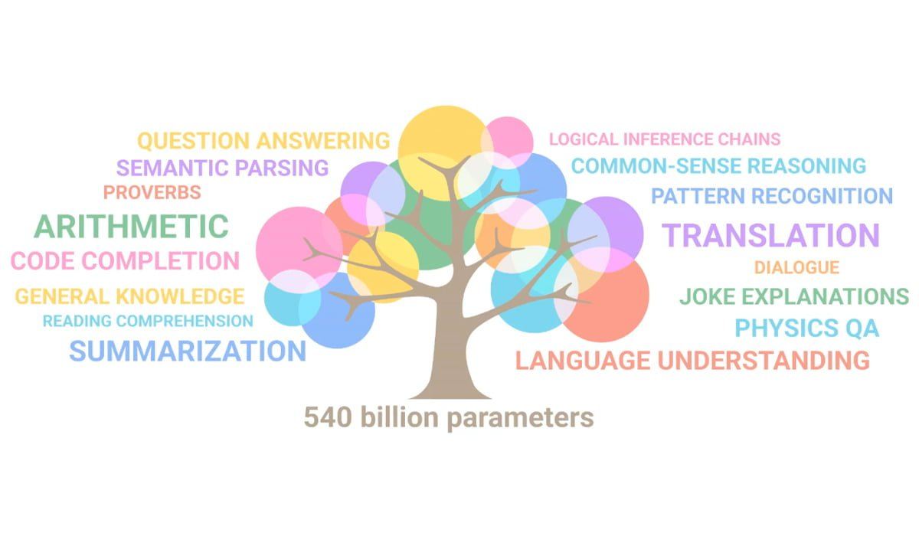

XXX
GEN AI VS TRADITIONAL AI
NLP VS LLM
What can Gen AI do and cannot do
Use cases mapping examples
OWNER : TBD
XXX
XXX
XXX
XXX

Slide 4

About us
AI HISTORY & EVOLUTION
USE RESEARCH
OWNER : TBD
XXX

Slide 5

APPENDIX

Slide 6
Problem
Market gap
Customers
Financials
New businesses need organizational tools, but are using old or outdated products
10% increase of task management tools proves that there's consumer interest for more simple management tools and technology
Purchases of task management software was up by $2 million in 2019
Costs
Usability
Loss of sales by not offering easier management tools that push teams to the finish line
Customers want something that’s easy to adopt and simple to use

Slide 7
Solution
Close the gap
Target audience
Our product makes managing tasks easier, and no other product on the market offers the same benefits
Gen Z (18-25 years old)
Cost savings
Easy to use
Reduce costs for client by helping project managers stay on target within deadlines
A simple product that gives businesses the information they need in order to complete projects on time

Slide 8




Product Overview
Unique
First to market
Tested
Authentic
Only product specifically dedicated to task management​
First beautifully designed product that's both stylish and functional
Conducted testing with start ups in the area
Designed with the help and input of software experts

Slide 9

Product benefits
Simple and efficient to use​
Quick customer service assistance​
Free 90-day trial for new customers​​

Slide 10

Company overview

Slide 11

Business Model
Research​
We based our research on market trends and software sales ​
Abstract​
We believe people need new management tools to help businesses achieve their OKRs​
Design​
Minimalist design and easy to use ​

Slide 12
Market overview
$3B
$2B
$1B
Opportunity to build​
Fully inclusive market​
Total addressable market​
Freedom to invent​
Selectively inclusive market​
Serviceable available market​
​
Few competitors​
Specifically targeted market​
Serviceable obtainable market​
​

Slide 13

Market Comparison
Opportunity to build​
Fully inclusive market​
Total addressable market​
Freedom to invent​
Selectively inclusive market​
Serviceable available market​
​
Few competitors​
Specifically targeted market​
Serviceable obtainable market​
​

Slide 14
Our competition
Contoso​
Competitors​
Our product is priced below that of other task management tools on the market​
Simple and easy to use app and website, compared to the complex tools of our competitors​
Affordability is the main draw for our consumers to our product​
Company A​ Product is more expensive​
Companies B & C ​ Product is expensive and inconvenient to use​
Companies D & E​ Product is affordable, but inconvenient to use

Slide 15
competition
Convenient
Contoso
A
Expensive​
Affordable
B
D
E
C
Inconvenient​

Slide 16
Growth strategy
How we’ll scale in the future​
Feb 20xx
May 20xx
Oct 20xx
Distribute the app to local start ups to help establish the product
Release the app to the general public and monitor press and regional market trends
Gather feedback from the start up community to expand availability of the product

Slide 17
Two-year action plan
Supply volunteers​
Run focus groups​
Gather feedback​
20XX
Jan
Feb
Mar
Apr
May
Jun
Jul
Aug
Sep
Oct
Nov
Dec
Test with start ups​
Regional launch​
Deliver to consumers​
20XX
Jan
Feb
Mar
Apr
May
Jun
Jul
Aug
Sep
Oct
Nov
Dec

Slide 18

Financials
 | Year 1 | Year 2 | year 3
Detailers​ | 5,000​ | 40,000​ | 160,000​ | ​
Users​ | 50,000​ | 400,000​ | 1,600,000​ | ​
Sales​ | 500,000​ | 4,000,000​ | 16,000,000​ | ​
Average Price per Sale​ | 75​ | 80​ | 90​ | ​
Revenue @ 15%​ | 5,625,000​ | 48,000,000​ | 216,000,000​ | ​
Gross Profit​ | 5,625,000​ | 48,000,000​ | 216,000,000​ | ​
Expenses​ | ​ | ​ | ​ | ​
Sales & Marketing​ | 5,062,500​ | 38,400,000​ | 151,200,000​ | ​
Customer Service​ | 1,687,500​ | 9,600,000​ | 21,600,000​ | 70%​
Product Development​ | 562,500​ | 2,400,000​ | 10,800,000​ | 10%​
Research​ | 281,250​ | 2,400,000​ | 4,320,000​ | 5%​
Total Expenses​ | 7,593,750​ | 52,800,000​ | 187,920,000​ | 2%​

Slide 19
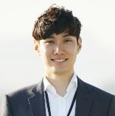


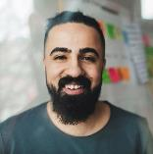
Meet the team
Takuma Hayashi​​
Mirjam Nilsson​​
Flora Berggren​​
Rajesh Santoshi​​
President​
Chief Executive Officer​
Chief Operations Officer​
VP Marketing​

Slide 20








The Full team
Takuma Hayashi​
Mirjam Nilsson​​
Flora Berggren​​
Rajesh Santoshi​​
President​
Chief Executive Officer​
Chief Operations Officer​
VP Marketing​
Graham Barnes​
Rowan Murphy​
Elizabeth Moore​
Robin Kline​
VP Product​
SEO Strategist​
Product Designer​
Content Developer​

Slide 21

Summary
At Contoso, we believe in giving 110%. By closing the loop on task management and using the latest technology, we help businesses grow and nurture a consumer-first mindset. We thrive because of our market knowledge and a great team behind our product. As our CEO says, "Efficiencies will come from proactively transforming how we do business."

Slide 22
Thank you
Mirjam Nilsson​​
206-555-0146​
mirjam@contoso.com​
www.contoso.com​

